Slide 1

PCB Design and Fabrication

Slide 2
Building circuits:
Requirements:
Identifying the part needed
Reading the datasheet
Knowledge in circuit theory

Slide 3
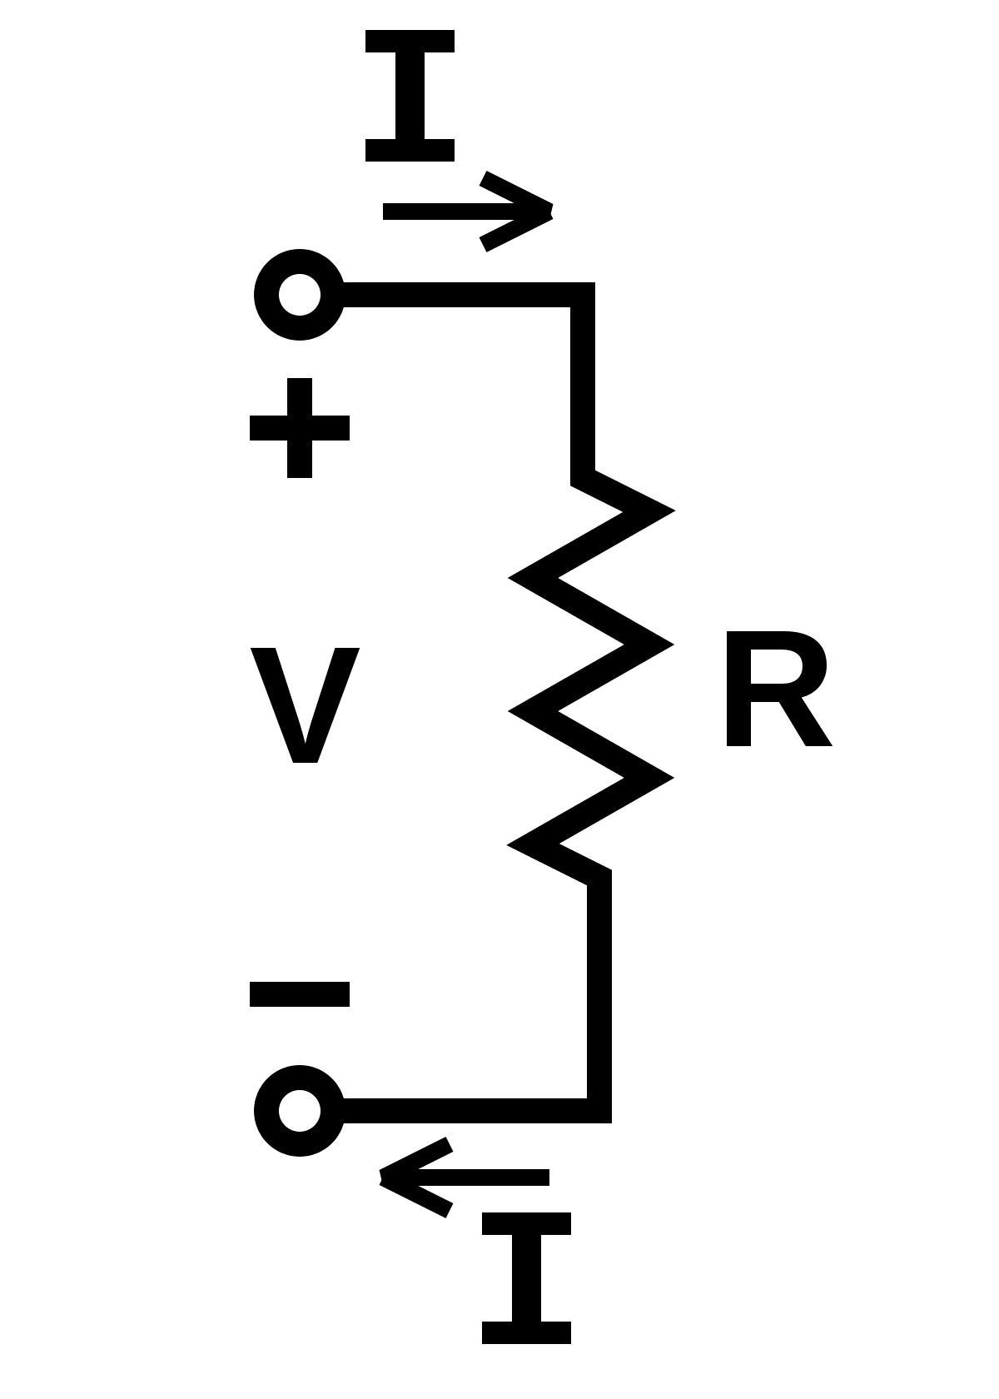
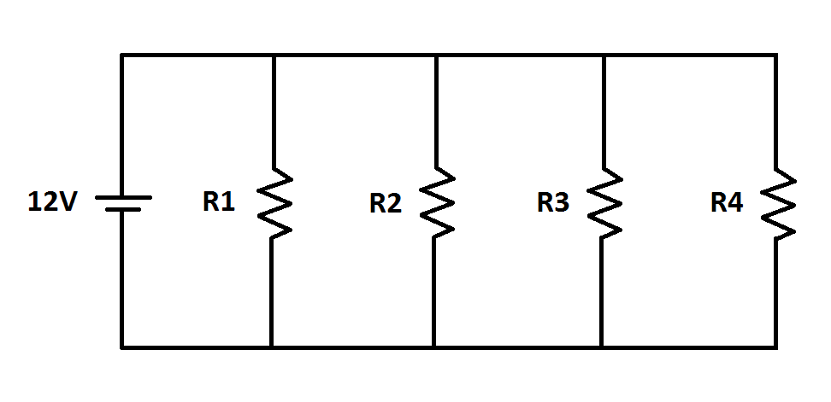
Building circuits:
Basics of Circuits:
Ohm’s law:

Slide 4
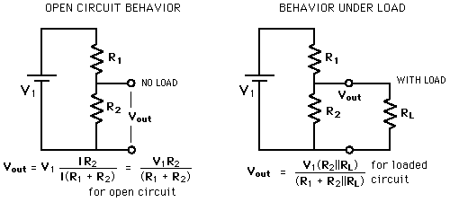
Building circuits:
Basics of Circuits:
Voltage Divider:

Slide 5
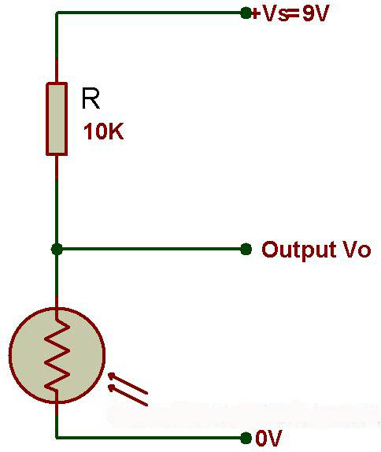
Building circuits:
Basics of Circuits:
Voltage Divider:

Slide 6
Building circuits:
Basics of Circuits:
Voltage Divider:

Slide 7
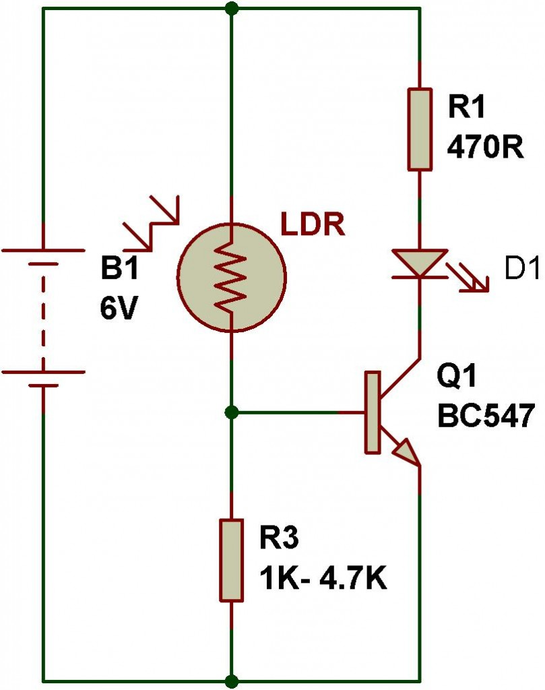
Building circuits:
Application:
Using transistor as switch

Slide 8
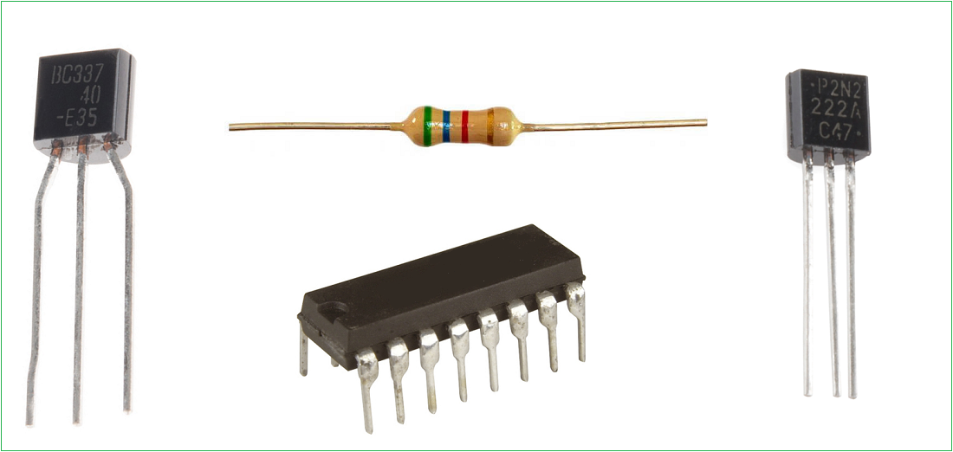
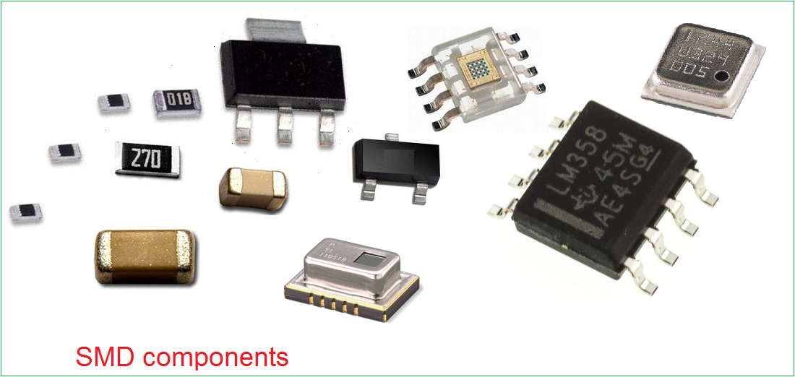
choosing components for pcb design:
PTH vs SMD:

Slide 9
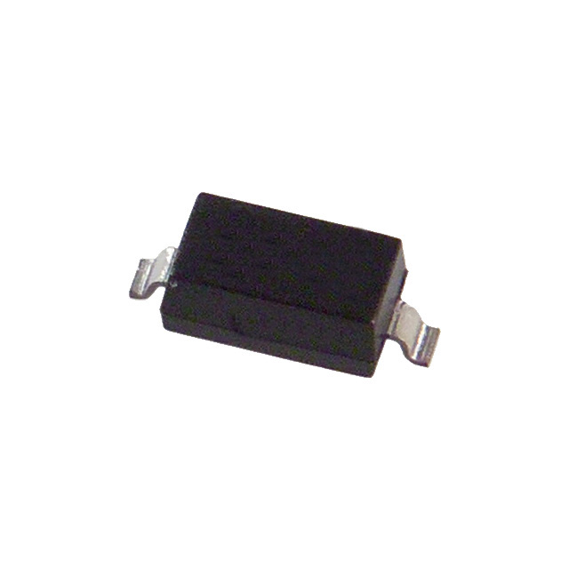
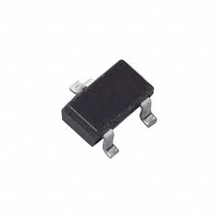
choosing components for pcb design:
Commonly used IC Packages:

Slide 10
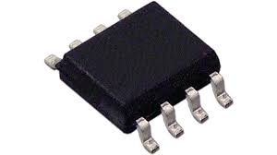
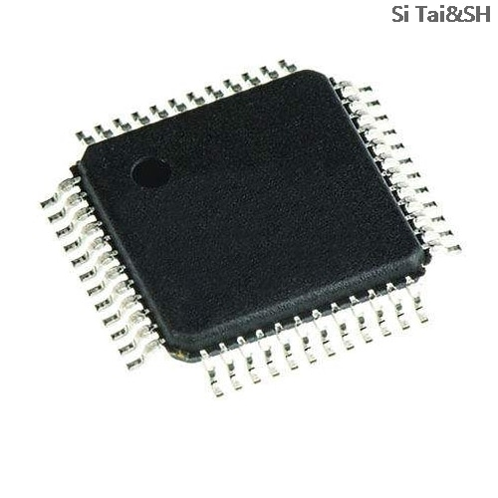
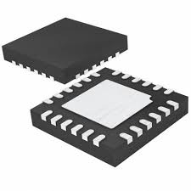
choosing components for pcb design:
Commonly used IC Packages:

Slide 11
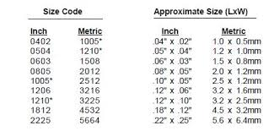
choosing components for pcb design:
Resistor Packages:

Slide 12
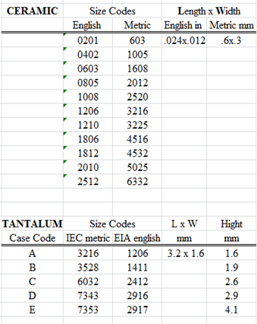
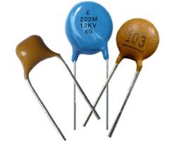
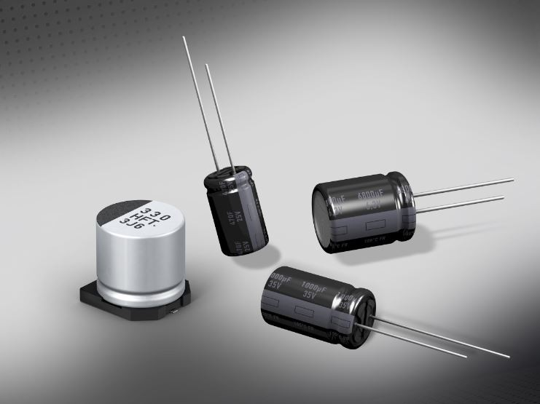
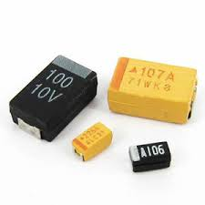
choosing components for pcb design:
Capacitor Types and Packages:

Slide 13
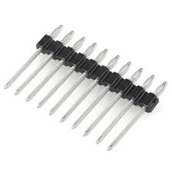
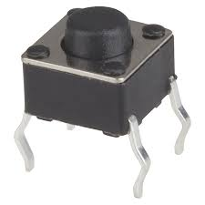
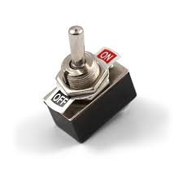
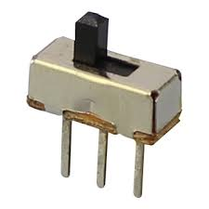
choosing components for pcb design:
Miscellaneous Components:

Slide 14
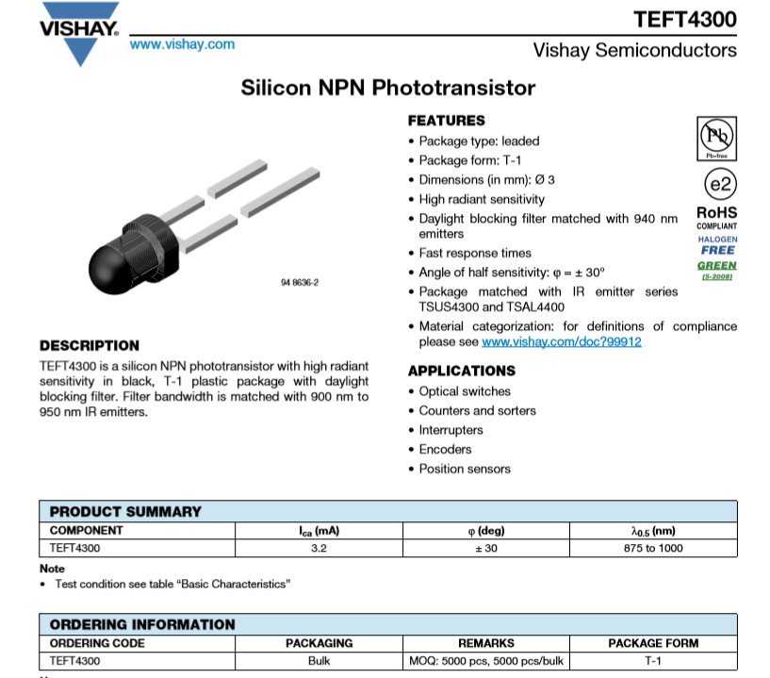
The Datasheet:
Description and Features:

Slide 15
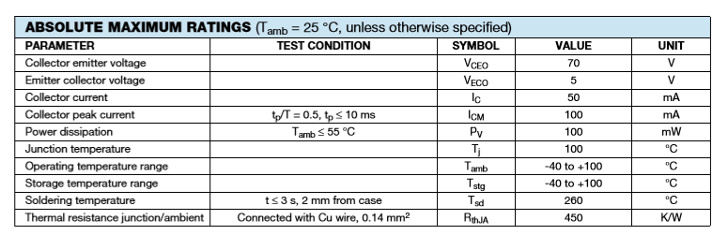
The Datasheet:
Absolute Maximum Ratings and Electrical Characteristics:

Slide 16
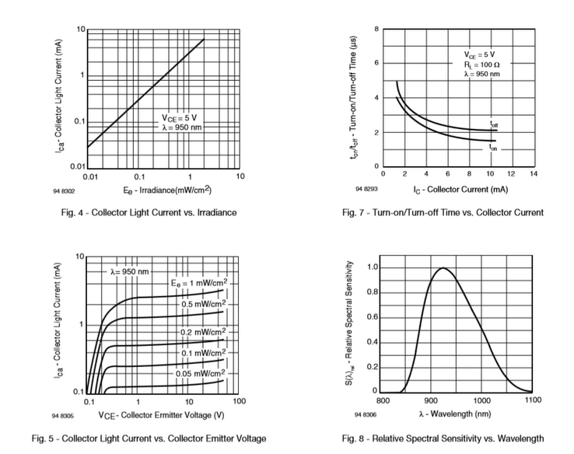
The Datasheet:
Basic Characteristics:

Slide 17
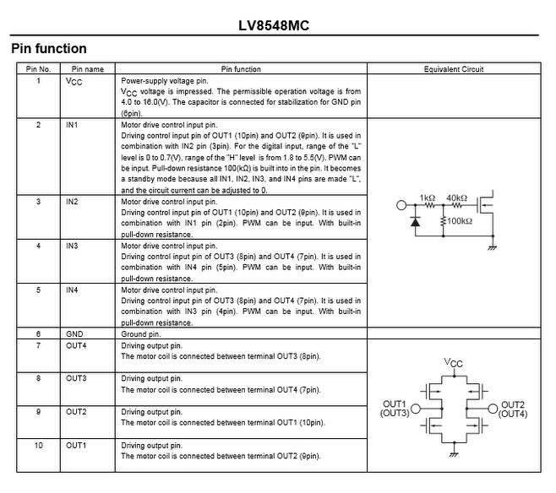
The Datasheet:
Pin Description:

Slide 18
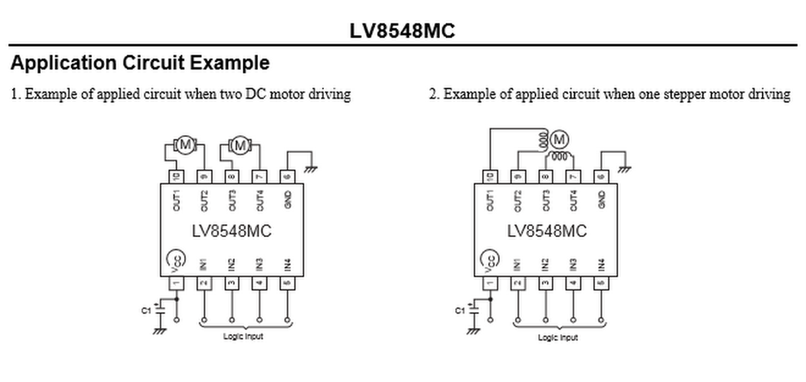
The Datasheet:
Practical Application:

Slide 19
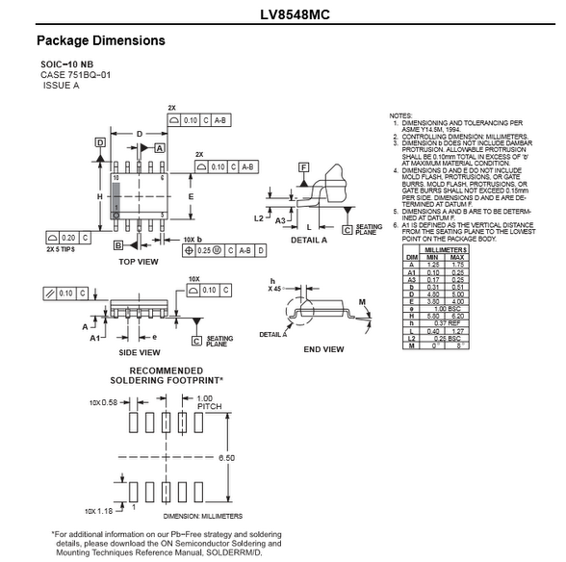
The Datasheet:
Package Dimensions:

Slide 20
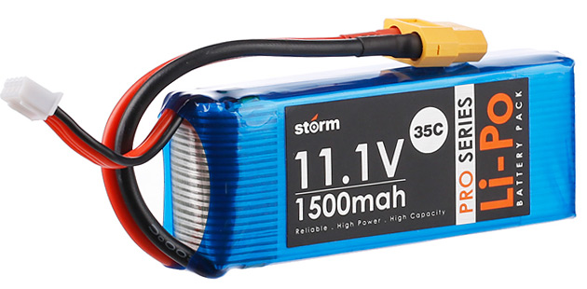
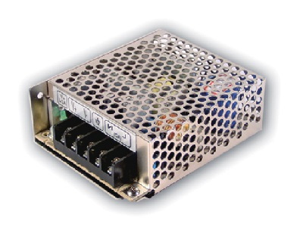
Powering our device:
Supply Options:
Unregulated and Regulated Supplies:

Slide 21
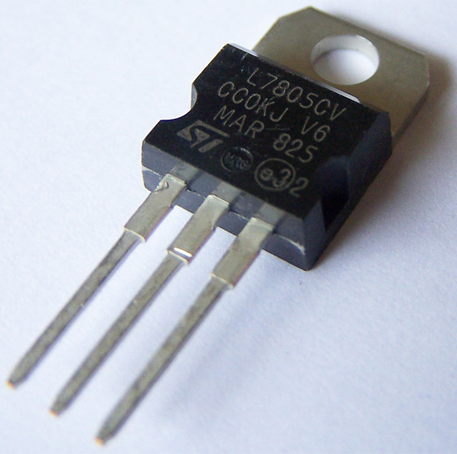
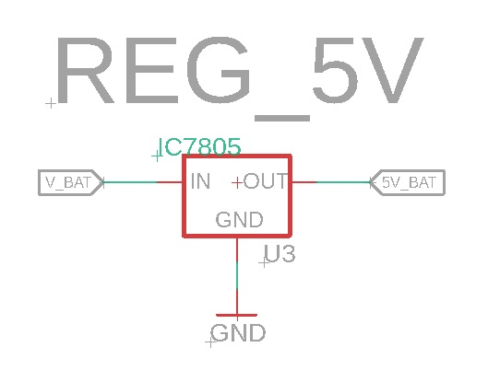
Regulating the power:
Options: Linear vs Switching
Linear:

Slide 22
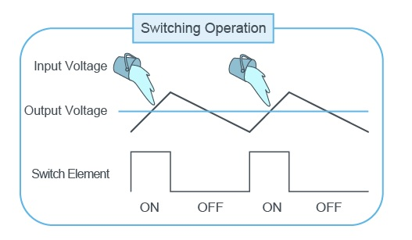
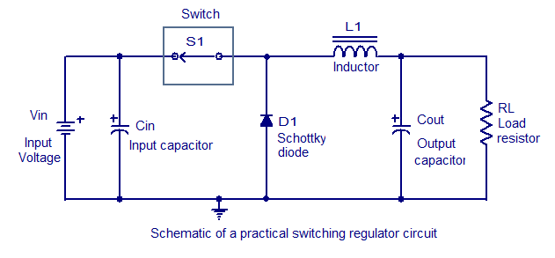
Regulating the power:
Options: Linear vs Switching
Switching:

Slide 23
Regulating the power:
Options: Linear vs Switching
Switching:

Slide 24
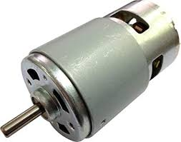
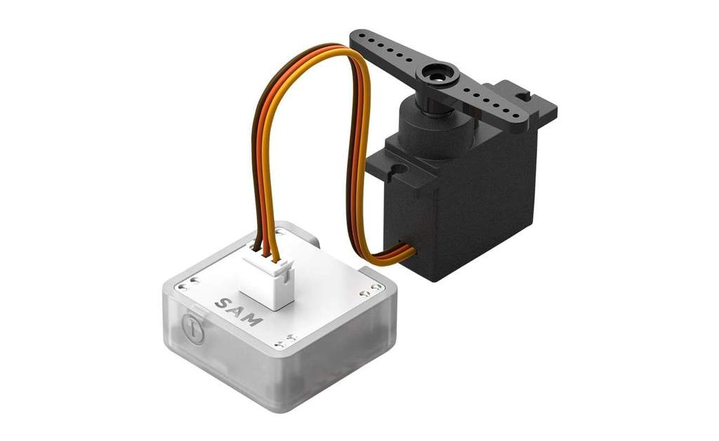
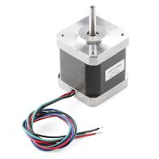
TYPES OF mOTORS:
DC VS SERVO VS STEPPER:

Slide 25
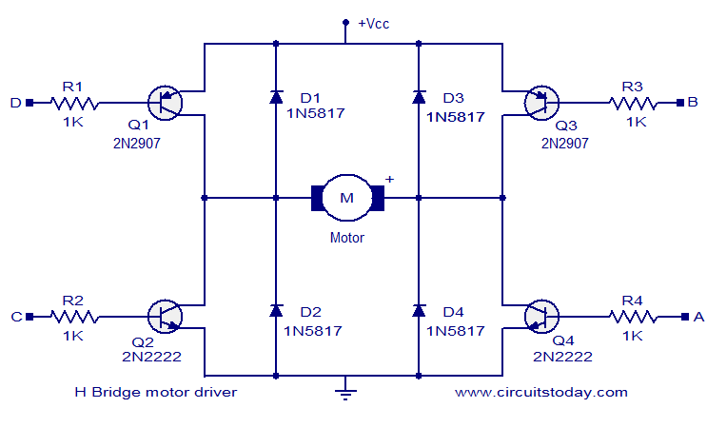
Motor Driver:
H-Bridge:

Slide 26
RECAP:
Ohm’s Law
Voltage Divider
Component Choice
Datasheet
H-Bridge

Slide 27
Building microcontroller based projects

Slide 28
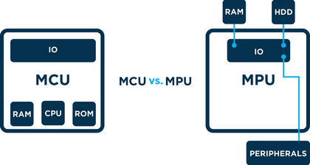
Microprocessors vs Microcontrollers

Slide 29
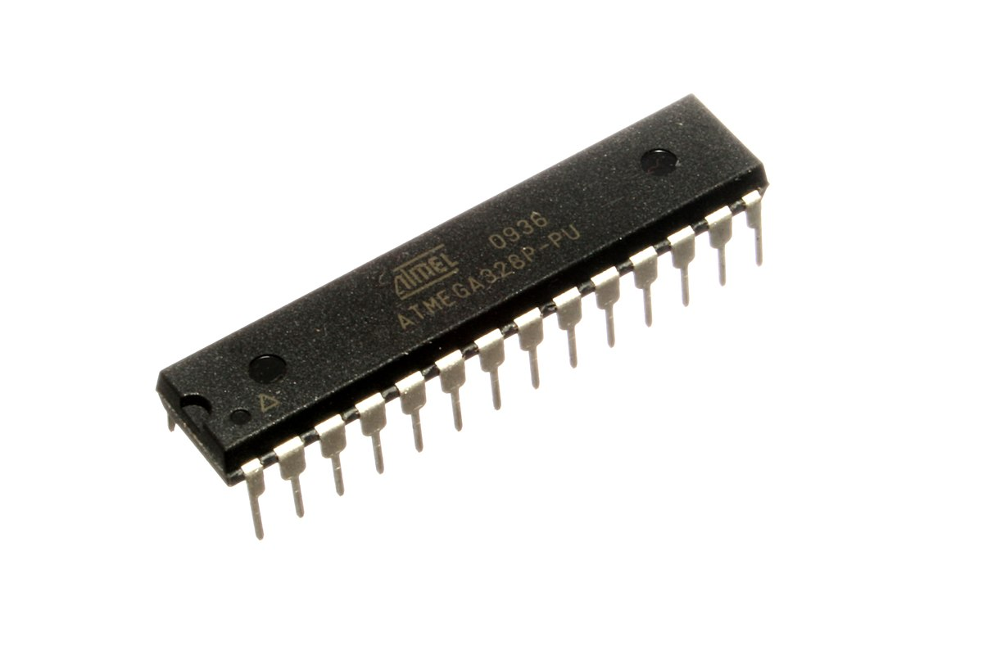
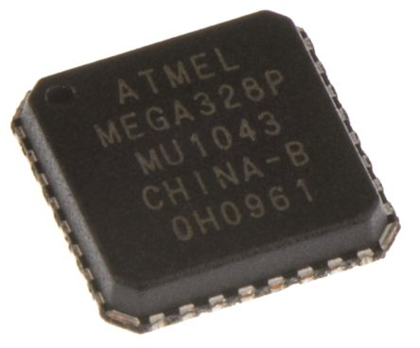
ATMEGA328P:

Slide 30
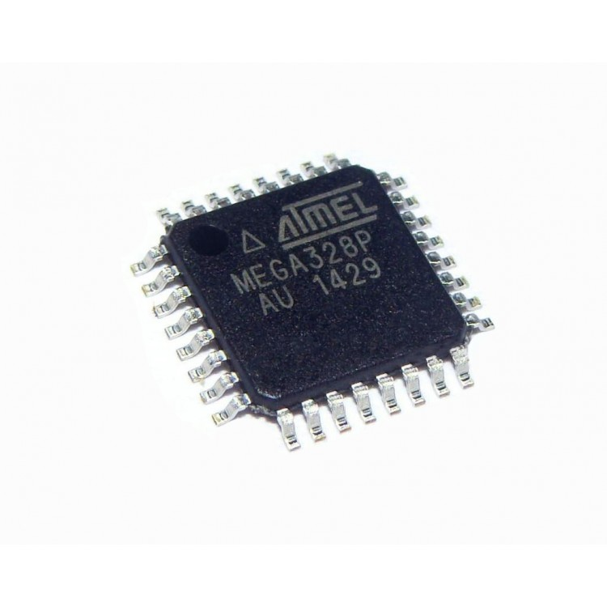
ATMEGA328P:

Slide 31
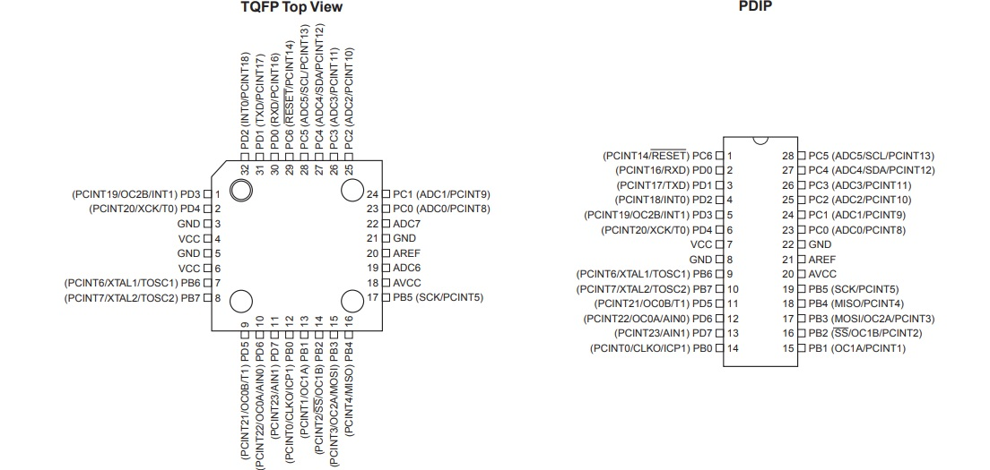
ATMEGA328P:

Slide 32
Minimal Operational Requirements of a Microcontroller:
Power Supply
Clock
Hardware Reset
Programming Interface
User Interface

Slide 33
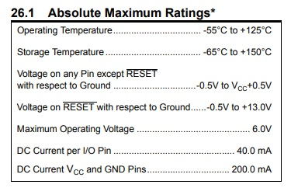
Power Supply
Estimate the total power required.

Slide 34
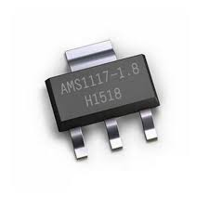
Power Supply

Slide 35
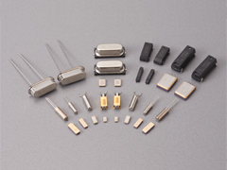
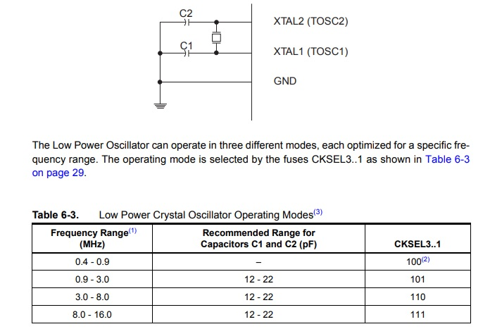
Clock
Crystal Oscillator

Slide 36
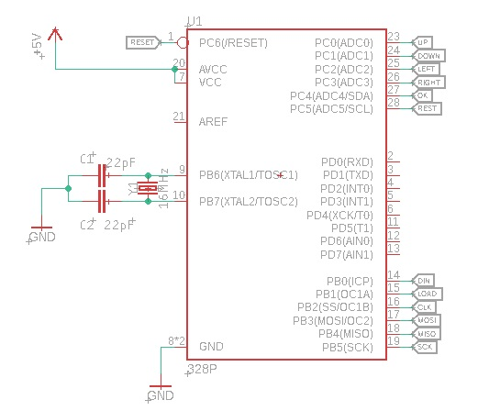
Clock
Crystal Oscillator

Slide 37
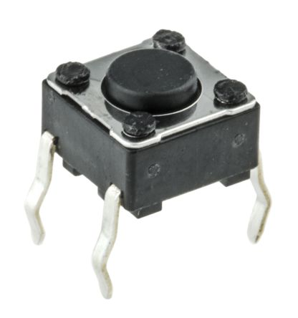
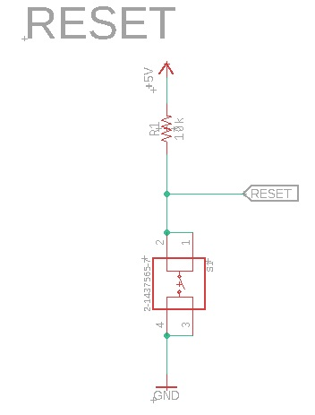
Reset
Atmega328p resets when a low signal is applied to the RESET pin for more than one clock cycle

Slide 38
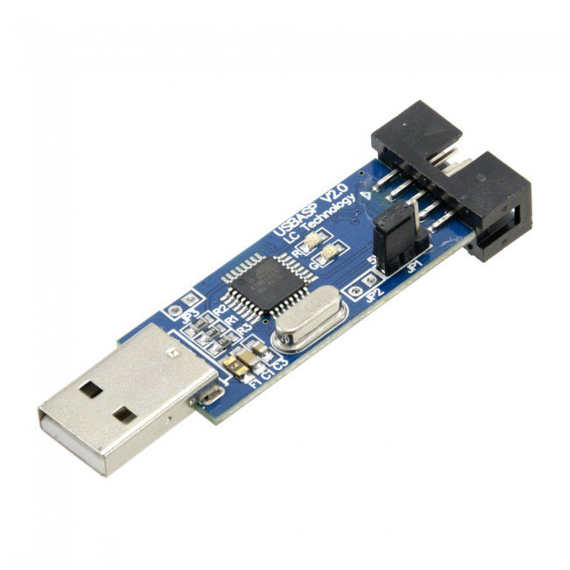

Programming Interface

